Slide 1

City of Livonia Recycling Survey - July 2023
August 15, 2023

Slide 2

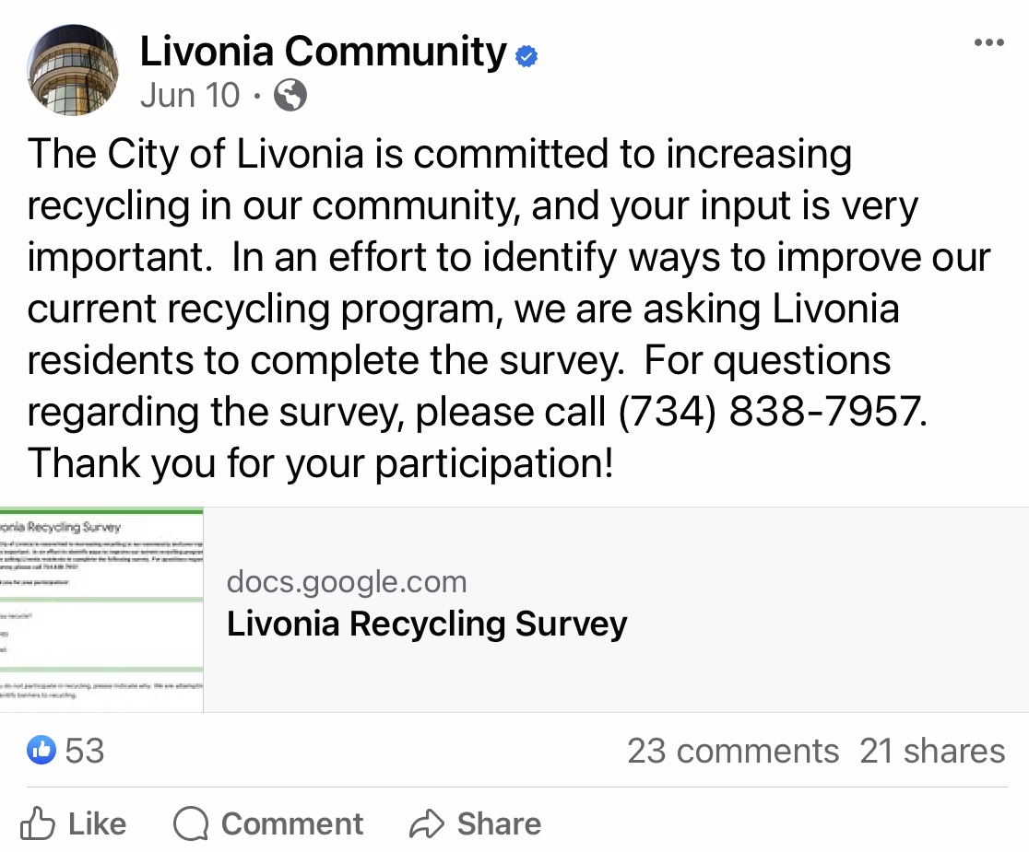
Recycling Survey – Current Results
Launched June 10, 2023
Survey Communication
  Livonia Community FB Post
  Greenleaf Commission FB Post
  Friday Musings
  Vote.Run.Serve
  Passport to Safety
1,029 Survey Responses

Slide 3
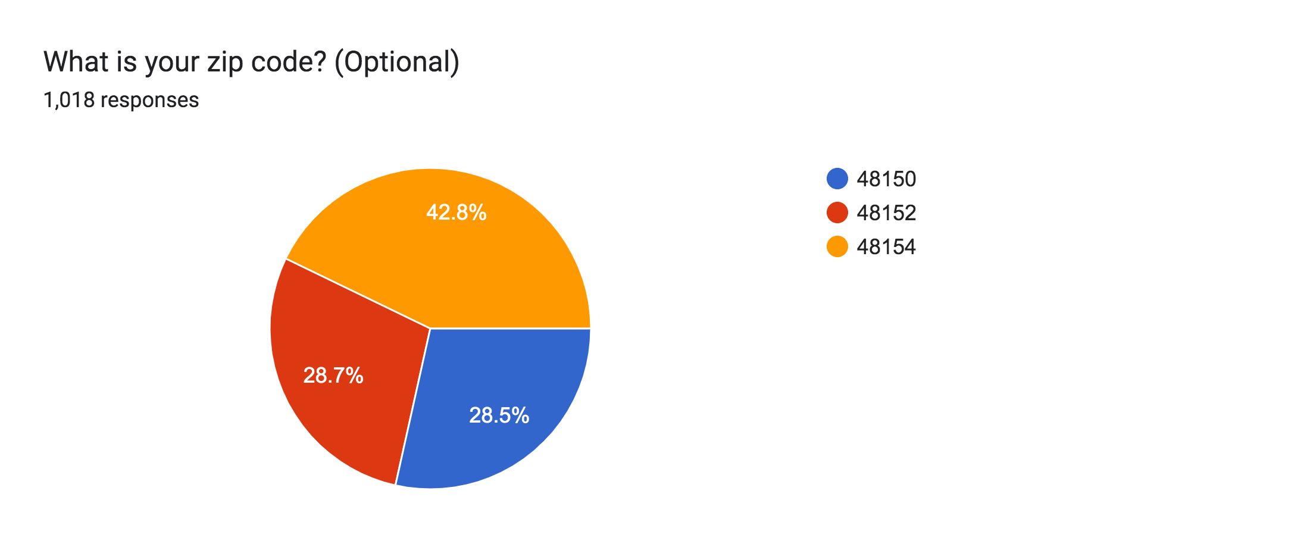
Recycling Survey – Current Results

Slide 4
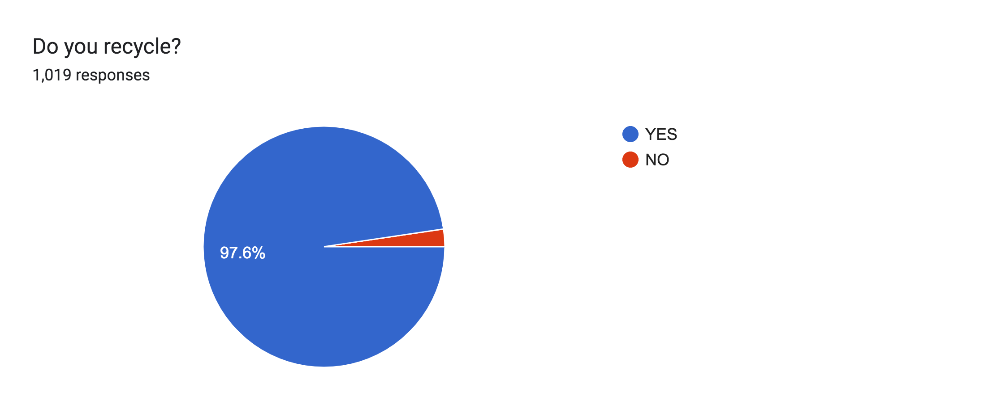
Recycling Survey – Current Results
2.4%

Slide 5
Recycling Survey – Current Results
If you do not participate in recycling, please indicate why. We are attempting to identify barriers to recycling. (Representative Sample)
Bins too small hard to carry out to curb
Watching GFL dump separated recycling into the garbage anyway is frustrating!
No bin at our house. Ease to get one isn't there
I understand that the recycling really doesn’t happen. I don’t want to remove
labels , plastic rinds, etc., just to have items not be truly recycled.
Laziness
Bins are too small.
We need a bin and the small boxes are too tiny anyways.
You need something similar to what Dearborn has…. Every resident
has a big garbage can recycling bin.
There is no option for recycling in my apartment complex
I’d recycle more with a bigger can

Slide 6
Recycling Survey – Current Results
If so, what do you recycle?

Slide 7
Recycling Survey – Current Results
If Other, please specify items you recycle. (Representative Sample)
I recycle hazardous materials and electronics as well at ERG in Livonia.
I think the city needs to promote their partnership with them more.
Every single week I see TVs and electronics thrown away that could
have been recycled at ERG or another similar place.
Batteries
Aluminum Foil
Plastic Bags at Grocery Stores
Styrofoam, Electronics (at Available Facilities)
Batteries, Motor Oil

Slide 8
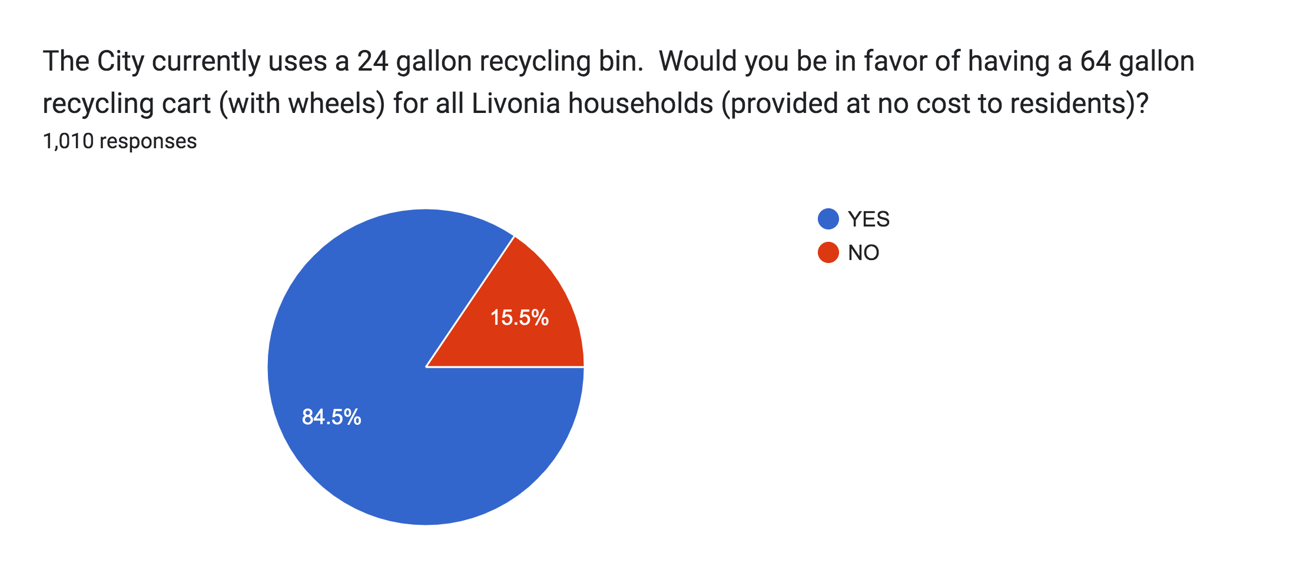
Recycling Survey – Current Results

Slide 9
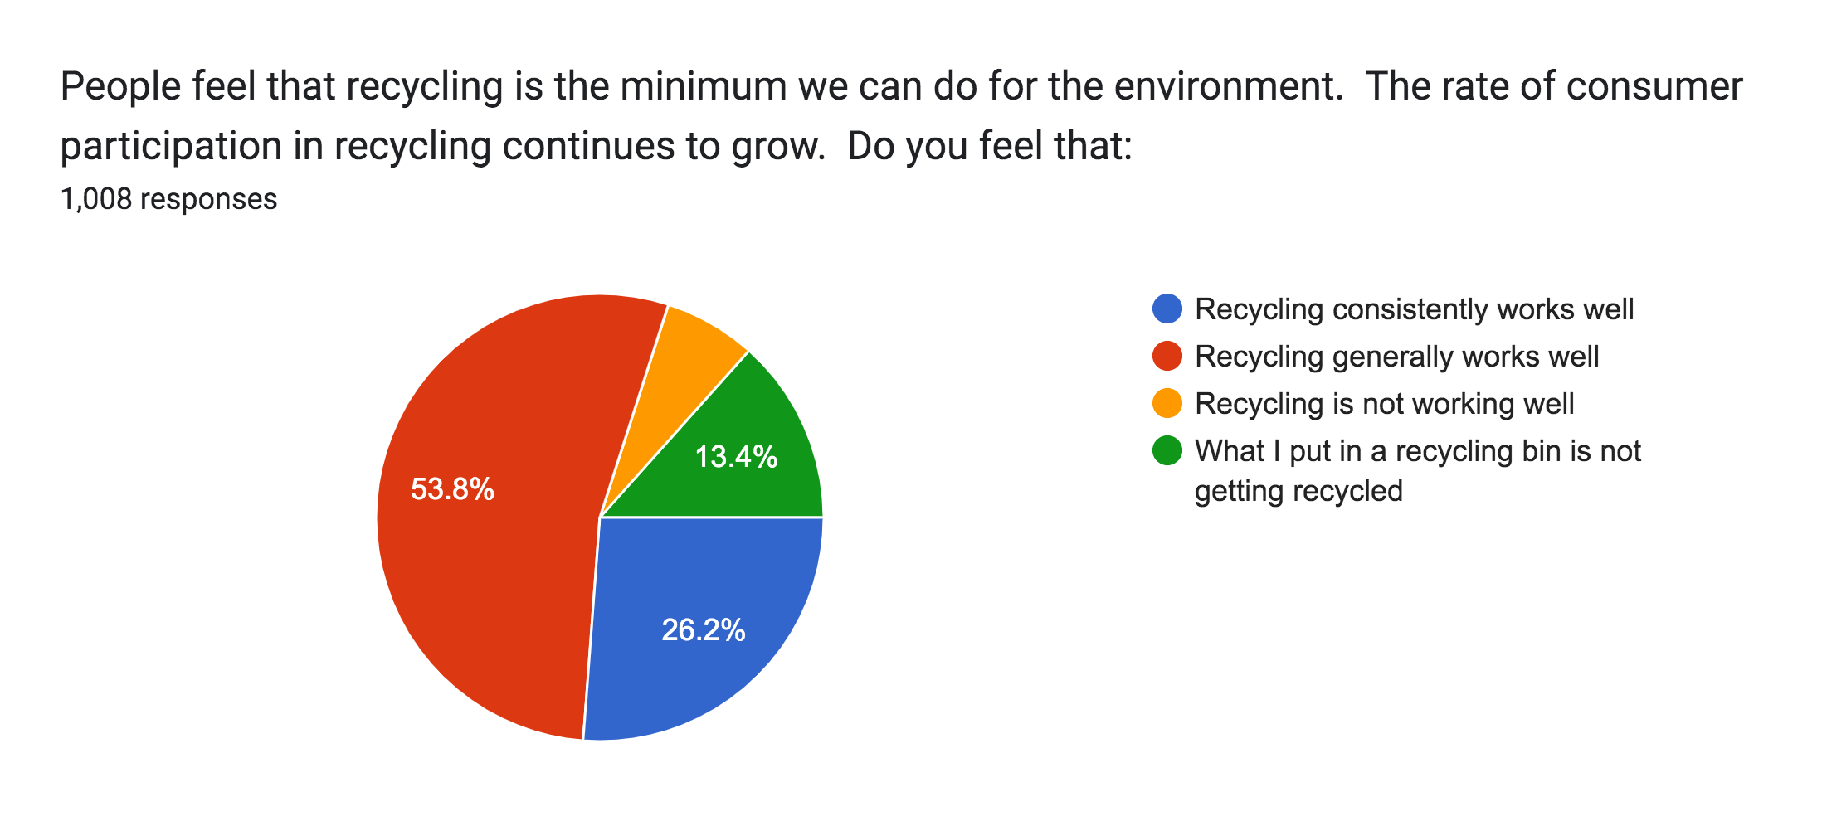
Recycling Survey – Current Results
6.6%

Slide 10
Recycling Survey – Current Results
Which programs are you aware of that the City of Livonia currently
offers to residents?

Slide 11
Recycling Survey – Current Results
What are your recommendations for making recycling easier in Livonia?
(Representative Sample)
To be honest, I think Livonia makes it pretty easy. How can
I help get the word out?
Bigger bins
Larger bins
Use large carts for both recycling and solid waste curbside pickup
Food compost recycling
Have large recycling containers with lids
Styrofoam recycling

Slide 12
Recycling Survey – Current Results
What is the best way to communicate City of Livonia recycling
information to you? (Representative Sample)
Primary Source of Recycling Information
  City Social Media
  City Website
  Combination of Both Primary Sources Information
Secondary Source of Information (“Reminders”)
  E-mail/Texts
  U.S. Mail
  Newsletters/Magazines
  More Electronic v Print Material for Secondary Sources Information

Slide 13
Recycling Survey – Current Results
If Other, please let us know the best way to communicate City of Livonia
recycling information to you
169 responses
Email
U.S. Mail
Facebook
Livonia Magazine
GFL Flyer
Detailed recycling information that can be saved

